Slide 1
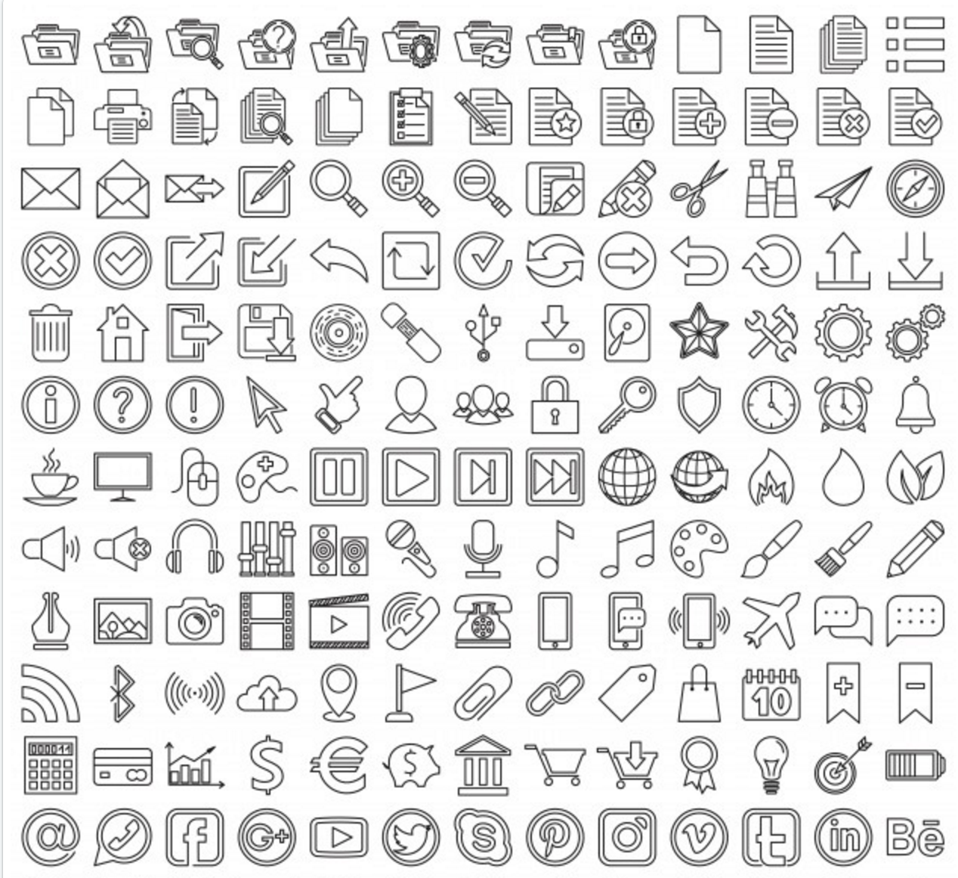

Python + IOT
Course 5
Ver. 01
Copyright @ 2018 Innovaker

Slide 2

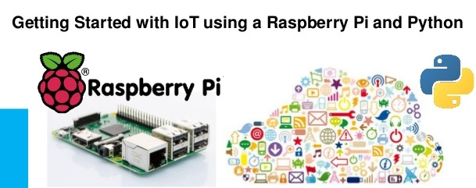
Course 4 Summary
Basic introduction of electric circuit
What is a button?
What is a buzzer?
Demo project --- button control buzzer project
What is a relay?
2
Copyright @ 2018 Innovaker

Slide 3
Quick review basic concept of Electricity
Electricity is the movement of electrons. Electrons create charge, which we can harness to do work. Your lightbulb, your stereo, your phone, etc., are all harnessing the movement of the electrons in order to do work. They all operate using the same basic power source: the movement of electrons.
The three basic principles for this tutorial can be explained using electrons, or more specifically, the charge they create:
Voltage is the difference in charge between two points.
Current is the rate at which charge is flowing.
Resistance is a material’s tendency to resist the flow of charge (current).
3
Copyright @ 2018 Innovaker
Notes:
Teacher notes:
Electricity is a natural phenomenon that occurs throughout nature and takes many different forms. In this tutorial we’ll focus on current electricity: the stuff that powers our electronic gadgets. Our goal is NOT to understand how electricity flows from a power source through wires, lighting up LEDs, spinning motors, and powering our communication devices.
Electricity is briefly defined as the flow of electric charge, but there’s so much behind that simple statement. Where do the charges come from? How do we move them? Where do they move to? How does an electric charge cause mechanical motion or make things light up? So many questions! To begin to explain what electricity is we need to zoom way in, beyond the matter and molecules, to the atoms that make up everything we interact with in life.
We do not have time to discuss and explain all of those concepts in this class, instead, we will focus on the electric circuit, and how its basic concept, and how it works.

Slide 4
What is Innovaker Digital Circuits Kits
Innovaker Digital Circuits Kit, is a special designed STEM kits. Using these tools from the kits, students can focus on electronic theory and programming instead of spending time making tedious wire connections. By undertaking a series of hands-on projects, students will learn how to develop rapid prototypes safely.
Innovaker Digital Circuits Kit includes:
. Pi PCB
. LED
. Resistor
. LCD
. Relay
. Buzzer
. Motion sensor
. Light sensor
. Button with cap
. 1uf Capacitor
. Temperature & Humidity Sensor
. Arduino Nano
4
Copyright @ 2018 Innovaker

Slide 5
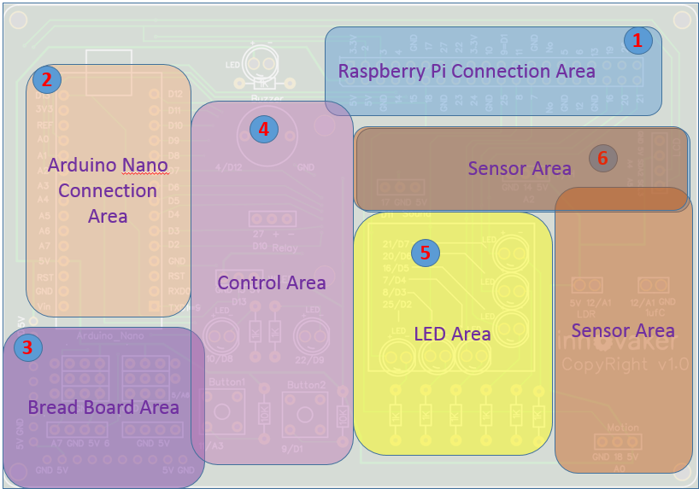
Innovaker Digital Circuits Kits layout
Innovaker Digital Circuits Kit, is a special designed STEM kits. It has built in Arduino Nano, and can connect to external Raspberry Pi.
5
Copyright @ 2018 Innovaker

Slide 6

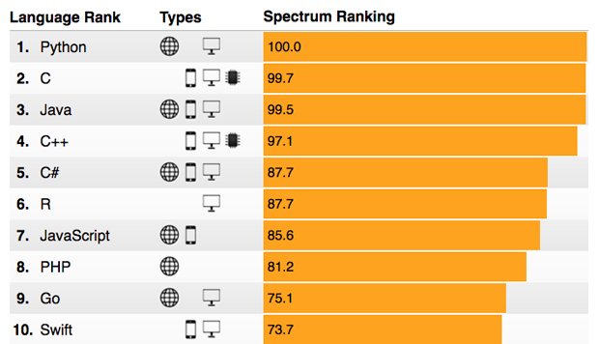
Raspberry Pi
remote access
option 2
Use network cable to connect with router to get IP
Connect Pi with router with ethernet cable, start Pi, the IP will be displayed on LCD, then remote connect to Raspberry Pi through VNC viewer.
Option 1: use monitor / keyboard / mouse to connect to wifi (see previous slide)
Copyright @ 2018 Innovaker
Notes:
IP address
Get Pi IP address is one important step to use Pi with laptop or other computer.
If IP address for example as “192.168.0.15” is displayed on LCD, go to chapter VNC.
Here is workflow how to get wifi IP address:
If there is no IP address is displayed on LCD, there are three ways to get IP.
Use monitor / keyboard / mouse to connect to wifi
Use network cable to connect with router to get IP
Use smartphone hotspot to get IP
Following chapter will introduce above IP methods.
Innovaker Kits special feature (not come with Raspbian)
Option 2: Use network cable to connect with router to get IP
Connect Pi with router with ethernet cable, start Pi, the IP will be displayed on LCD, go to VNC chapter to setup Wifi or use directly.

Slide 7
Raspberry Pi
remote access
option 3
Use martphone hotspot to get IP
Set hotspot on smartphone,
the spot name “Pizhi”, password “innovaker”.
Start Pi with LCD, the LCD will display Pi IP of hotspot, go to VNC, then remote connect to Raspberry Pi through VNC viewer.
Option 1: use monitor / keyboard / mouse to connect to wifi (see previous slide)
Copyright @ 2018 Innovaker
Notes:
Innovaker Kits special feature (not come with Raspbian)
Option 3: Use martphone hotspot to get IP
Set hotspot on smartphone, the spot name “Pizhi”, password “innovaker”.
Start Pi with LCD, the LCD will display Pi IP of hotspot, go to VNC.

Slide 8
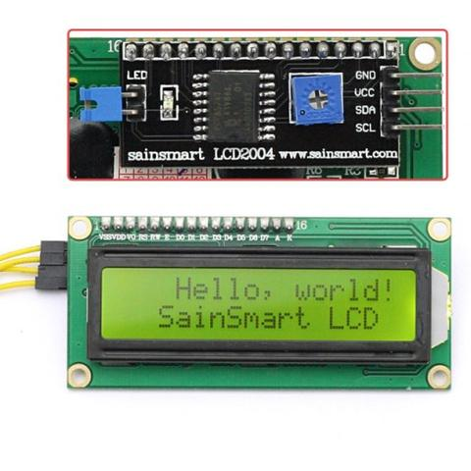
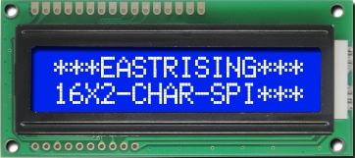
Electronic
component
--- LCD
LCD
The Liquid Crystal Display (LCD) is a type of screen that uses liquid crystals in order to create a display. A backlight is shown through a layer of liquid crystals, which produces either a colorized or monochrome color. When large arrays of them are put together, they can form large panels to display images or text. As a result, LCDs can be found all around us today — in our computers, cell phones, televisions, microwaves, clocks, and much more.
How does it work?
The LCD we will be using is a 16x2 screen that is enabled with I2C communication, allowing us to effectively use only 4 pins to display words onto our screen. Two of the pins are connected to 5V and ground in order to supply power to the device, while the other two pins are used to send data and communicate with the device.
Copyright @ 2018 Innovaker
Notes:
Teacher notes:
LCD
The Liquid Crystal Display (LCD) is a type of screen that uses liquid crystals in order to create a display. A backlight is shown through a layer of liquid crystals, which produces either a colorized or monochrome color. When large arrays of them are put together, they can form large panels to display images or text. As a result, LCDs can be found all around us today — in our computers, cell phones, televisions, microwaves, clocks, and much more.
How does it work?
The LCD we will be using is a 16x2 screen that is enabled with I2C communication, allowing us to effectively use only 4 pins to display words onto our screen. Two of the pins are connected to 5V and ground in order to supply power to the device, while the other two pins are used to send data and communicate with the device.

Slide 9
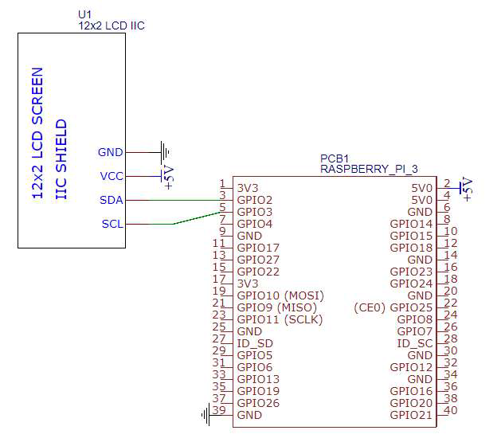
Electronic
component
--- LCD diagram
Copyright @ 2018 Innovaker
Notes:
Teacher notes:

Slide 10
Demo Project
LCD display I
import RPi.GPIO as GPIO import time from led4import import * from datetime import datetime | Here we have two additional imports led4import - LCD library datetime - python library for dates and time
def setup(): lcd_init() | lcd_init() - function to initialize the LCD
def main(): while True: lcd_string(str(datetime.now()), LCD_LINE_1) lcd_string("Innovaker 2017", LCD_LINE_2) time.sleep(60) | lcd_string(STRING, LINE #) - function to display strings on the LCD. Takes two parameters - the string to display and the line number to be displayed on.
Copyright @ 2018 Innovaker
Notes:
Teacher notes:
Writing the Code
The code we will be writing is based on a prewritten library to streamline the process of using our display. The following program displays the current time on the screen and refreshes every minute.

Slide 11
Demo Project
LCD display II
if __name__ == '__main__': try: setup() main() finally: lcd_byte(0x01, LCD_CMD) GPIO.cleanup() | lcd_byte(0x01, LCD_CMD)- clears the LCD display screen.
Copyright @ 2018 Innovaker
Notes:
Teacher notes:
Writing the Code
The code we will be writing is based on a prewritten library to streamline the process of using our display. The following program displays the current time on the screen and refreshes every minute.

Slide 12
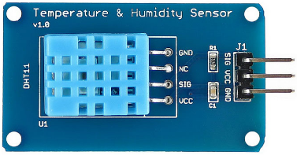
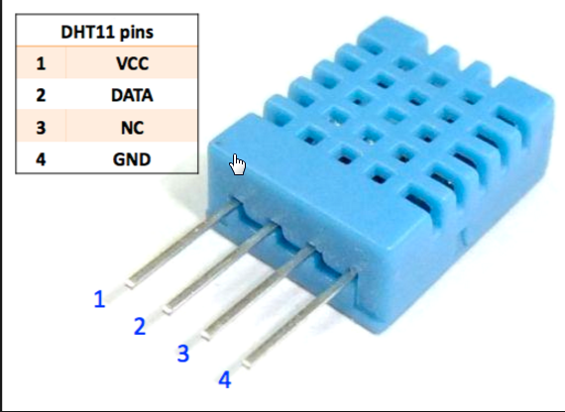
Electronic
component
--- temperature &
humidity sensor
Temperature & humidity sensor
There are a number of ways that temperature sensors are implemented, but the basic principle behind all of them is the ability to accurately measure the temperature of the surrounding environment and converts them into a digital signal that can be used. Effectively these temperature sensors act as digital thermometers.
How does it work?
The specific temperature sensor we will be working with is the DHT11, capable of detecting temperature readings between 0 - 50°C and humidity readings between 20% and 80%. The DHT11 has 3 pins attached to it: power, ground, and data out.
Copyright @ 2018 Innovaker
Notes:
Teacher notes:
Temperature & humidity sensor
There are a number of ways that temperature sensors are implemented, but the basic principle behind all of them is the ability to accurately measure the temperature of the surrounding environment and converts them into a digital signal that can be used. Effectively these temperature sensors act as digital thermometers.
How does it work?
The specific temperature sensor we will be working with is the DHT11, capable of detecting temperature readings between 0 - 50°C and humidity readings between 20% and 80%. The DHT11 has 3 pins attached to it: power, ground, and data out.

Slide 13
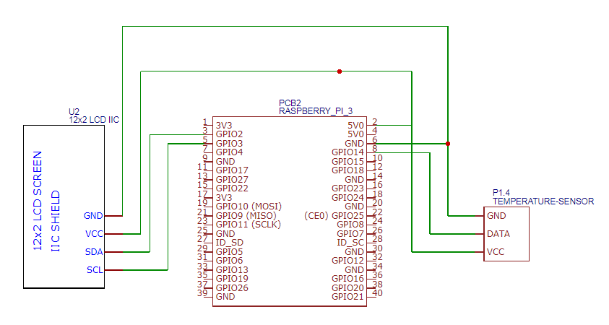
High temperature
alarm
diagram
Copyright @ 2018 Innovaker
Notes:
Teacher notes:

Slide 14
Demo Project
high temperature
alarm I
import smbus import time import dht11 import RPi.GPIO as GPIO from led4import import * TEMP_SENSOR = 14 | We have an additional import for the dht11 sensor in order to use its library
def setup(): GPIO.setmode(GPIO.BCM) lcd_init()
def main(): sensor_instance = dht11.DHT11(pin = TEMP_SENSOR) while True: result = sensor_instance.read() | In our main function, we use declare sensor_instance, an instance of the DHT11 temperature sensor
Copyright @ 2018 Innovaker
Notes:
Teacher notes:
Writing the Code
The following program takes in data from the DHT11 temperature sensor and displays it on a 16x2 LCD screen.

Slide 15
Demo Project
high temperature
alarm II
if result.is_valid(): lcd_string("Temperature: " + str(result.temperature) + "C", LCD_LINE_1) lcd_string("Humidity: " + str(result.humidity) + "%", LCD_LINE_2) time.sleep(3) lcd_string("Innovaker", LCD_LINE_1) lcd_string("Temperature Sensor", LCD_LINE_2) time.sleep(3) | Using this, we can obtain a reading of the sensor, which we set to the variable result. The result variable contains data for both the temperature and humidity, which are called upon to be displayed the LCD screen
if __name__ == '__main__': try: setup() main() finally: lcd_byte(0x01, LCD_CMD) GPIO.cleanup()
Copyright @ 2018 Innovaker
Notes:
Teacher notes:

Slide 16
Demo Project
additional demo
Copyright @ 2018 Innovaker
Notes:
Teacher notes:
additional demo
How to show more demo of use the button + LED + resistor circuit

Slide 17
summary
What we learned so far?
. Basic concept of electric circuit
. What is LCD?
. Demo project --- LCD project
. What is temperature & humidity sensor?
. Demo project --- temperature & humidity project
Copyright @ 2018 Innovaker
Notes:
Teacher notes:
Writing the Code (led.py)
To ensure that your program is readable to both computer and human eyes, make sure that you structure your programs in a way that coherent on what the purpose of the program is. This will also eliminate many of the bugs that occur in your code.

Slide 18

Congratulations On Finishing
Copyright @ 2018 Innovaker

